Slide 1



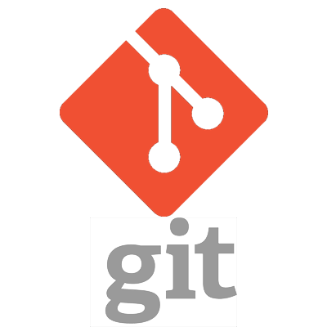
GitOps Based Continuous Delivery for Kubernetes with ArgoCD
Presenters:
Senthil Raja Chermapandian
Raman N

Slide 2
Agenda
GitOps
The birth of GitOps
What is GitOps really
Core Principles of GitOps
Benefits of GitOps
Push based Deployments
Pull based Deployments
Multiple Applications and Environments
CNCF and GitOps
ArgoCD
Core Concepts
Architecture
Syncing changes – Pull/Push Model
ArgoCD Component Overview
Installation Demo
ArgoCD Application Examples
Application Deployment Demo
ArgoCD ApplicationSet Examples
Application Set Demo
Helm chart - Hooks
Manifest Path Annotation
Feature Summary

Slide 3


Speakers
Senthil Raja Chermapandian
Principal Software Engineer, Ericsson
Organizer: KCD Chennai (kcdchennai.in)
Maintainer: github.com/senthilrch/kube-fledged
Interests: K8s, Cloud-native, MLOps, WebAssembly
Raman Narasimhan
Senior Software Engineer, Ericsson
Interests : K8s, Helm, ArgoCD, Seldon-Core

Slide 4
GitOps

Slide 5
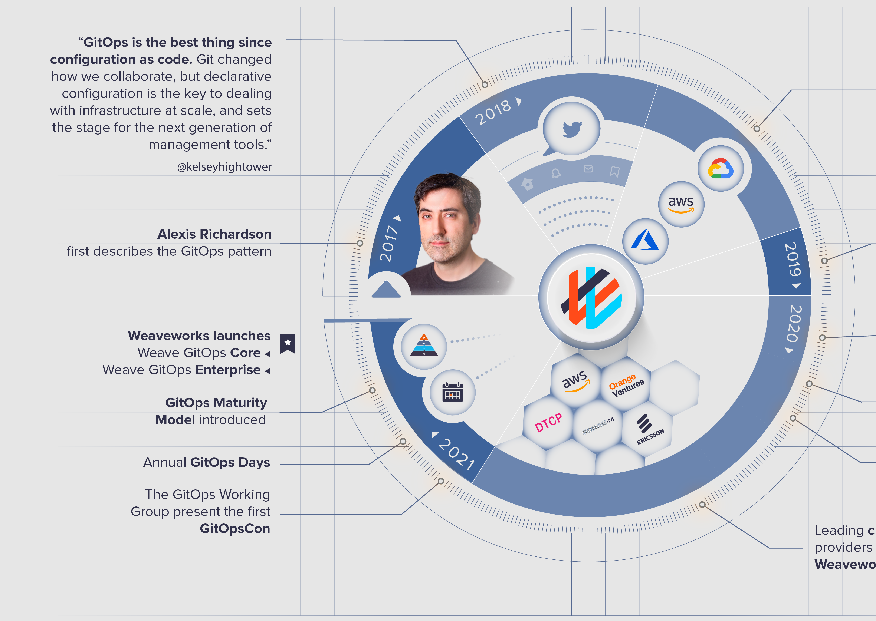
2017 – The birth of GitOps
GitOps is a modern way to manage cloud-native systems that are powered by Kubernetes.
It leverages a policy-as-code approach to define and manage every layer of the modern application stack - infrastructure, networking, appliction code, and the GitOps pipeline itself.
Source: https://www.weave.works/blog/the-history-of-gitops

Slide 6
What is GitOps really
GitOps leverages Git as the single source of truth to define every part of a cloud-native system.
Once declared in Git, a GitOps agent (ArgoCD) automatically applies all code, configuration, and policies across dev, test, staging, and production environments.
With GitOps, whenever there is any divergence between Git and what's running in a cluster, developers are alerted.
Depending on the case, Kubernetes reconcilers automatically update or roll back the cluster.
With Git at the center of the delivery pipelines, developers can use familiar tools to make pull requests to accelerate and simplify both application deployments and policies that govern software delivery end-to-end.
Source: https://www.weave.works/technologies/gitops/

Slide 7
Core Principles of GitOps
#1. Declarative: The entire system has to be described declaratively
#2. Versioned and immutable: The canonical desired system state is versioned in Git
#3. Pulled automatically: Approved changes are automatically applied to the system
#4. Continuously reconciled: Software agents to ensure correctness and alert on divergence
Source: https://www.weave.works/technologies/gitops/

Slide 8
Benefits of GitOps
Increased productivity
Enhanced developer experience
Improved audibility
Higher reliability
Consistency and standardization
Stronger security guardrails
Faster development & Better Ops

Slide 9
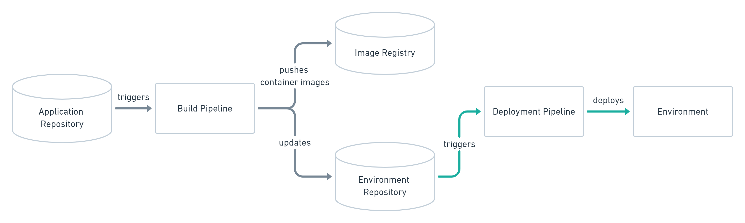
Push based Deployments
Source: https://www.gitops.tech/

Slide 10
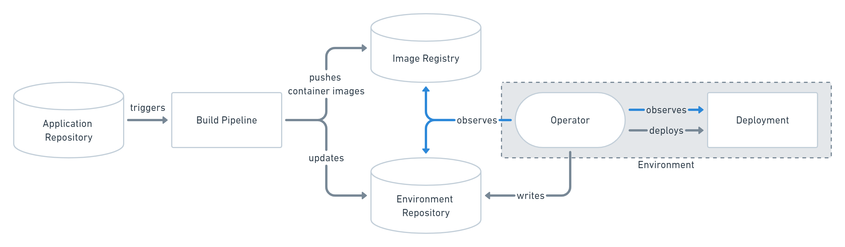
Pull based Deployments
Source: https://www.gitops.tech/

Slide 11
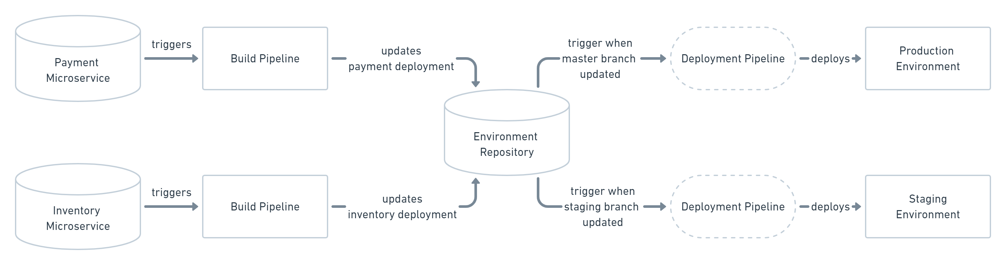
Working with multiple Applications and Environments
Source: https://www.gitops.tech/

Slide 12
CNCF and GitOps
Seeking to bring clarity to the core ideas of GitOps, the CNCF has taken steps to set up a governing body to oversee the progress of GitOps in a vendor-neutral manner.
The GitOps Working Group is established under the CNCF App Delivery SIG (special interest group) that aims to define a vendor-neutral meaning of GitOps. As a first step, they started the OpenGitOps Project.
https://github.com/cncf/tag-app-delivery/tree/main/gitops-wg
In a bid to bring consistency to GitOps, the GitOps Working Group has laid out the fundamental principles that govern GitOps.
https://opengitops.dev/

Slide 13
ArgoCD

Slide 14
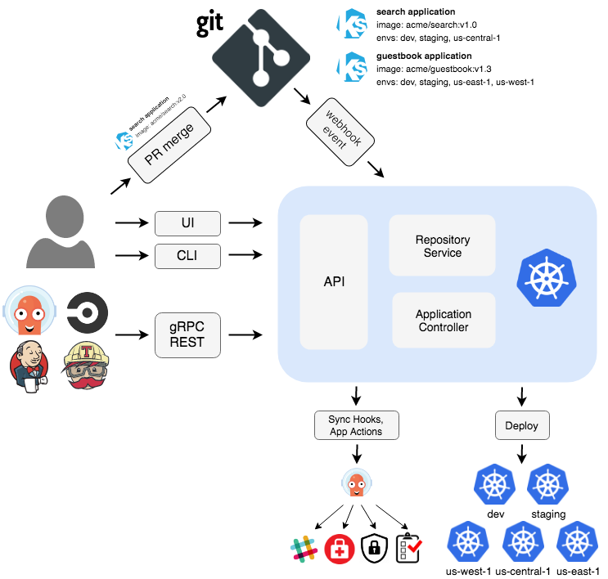
Architecture Diagram
New PR is merged into GitOps Repo & its details are passed onto ArgoCD via Webhoook event
ArgoCD generates manifests and applies them to the target clusters and sends notifications
3 Main components
API Server: End users interact with ArgoCD via the API Server using UI, CLI or APIs (REST or GRPC)
Repo Server: Generates manifests based on Git and saves to redis cache
Application controller: Applies the generated manifests to target clusters
Source: https://argo-cd.readthedocs.io/en/stable/#architecture

Slide 15
Core concepts
Application: A group of Kubernetes resources as defined by a manifest. This is a Custom Resource Definition (CRD). Defines the source (git repo, branch, dir containing the manifests) and the destination (Kubernetes cluster)
Application source type: Which Tool is used to build the application
Target state: The desired state of an application, as represented by files in a Git repository.
Live state: The live state of that application. What pods etc are deployed.
Sync: The process of making an application move to its target state. E.g., by applying changes to a Kubernetes cluster.
Sync status: Whether the live state matches the target state. Is the deployed application the same as Git says it should be?
Sync operation status: Whether a sync succeeded.
Refresh: Compare the latest code in Git with the live state. Figure out what is different.
Health: The health of the application, is it running correctly? Can it serve requests?

Slide 16
Sync Modes
Manual – either triggered by user or by automation
Automated – ArgoCD detects changes and updates application state - In sync or Out of sync / Healthy or Degraded
Optional configuration
Self Heal : ArgoCD can take corrective action if live state drifts from desired state due to accidental updates or manual changes on the cluster
Auto Prune: If a new version of an Application has removed few resources, then ArgoCD can detect this and remove the unnecessary resources from the cluster automatically

Slide 17
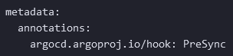
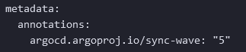
Sync Phases & Waves
Phases
Pre and Post sync phases can only contain hooks
PreSync: Execute prior to application of manifests
Sync: Execute after successful completion of PreSync hooks, at same time as the application of manifests.
Post-sync :Executes after all Sync hooks completed and were successful, application rollout was successful, and all resources in a Healthy state. Useful for running integration and health checks
Sync Waves
Each Sync phase can have one or more sync-waves that allow you to ensure that certain resources are healthy before subsequent resources are synced
Hooks and resources are assigned to wave zero by default.
The wave can be negative, so you can create a wave that runs before all other resources.

Slide 18
Pull & Push Model
Pull Model:
ArgoCD polls the git repository for changes every 3mins [configurable]
Additional overhead of polling the repository
Push Model:
After committing changes, use CI/CD pipeline to explicitly trigger ArgoCD Sync using cli `argocd app sync <appName>`
Recent versions of ArgoCD provide a provision to automate this using webhooks. Repository owner can configure a webhook in Git to notify ArgoCD about new commits as they happen

Slide 19
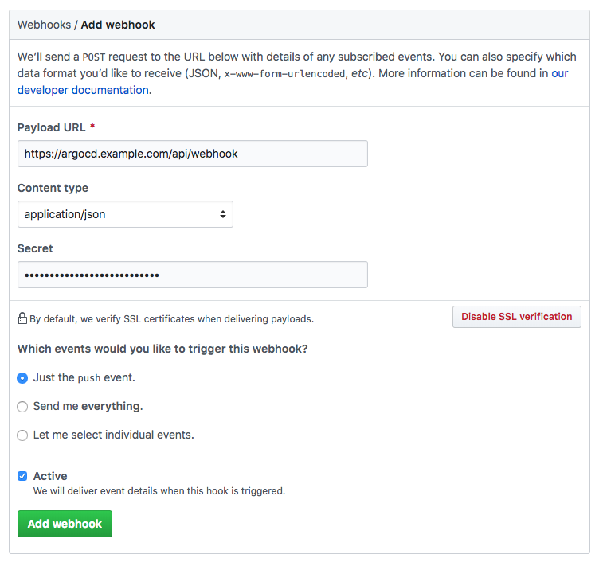
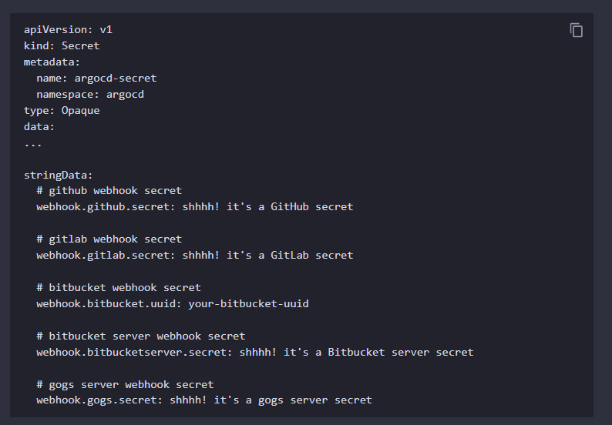
Push Model using Webhooks
Source: https://argo-cd.readthedocs.io/en/stable/operator-manual/webhook/#git-webhook-configuration

Slide 20
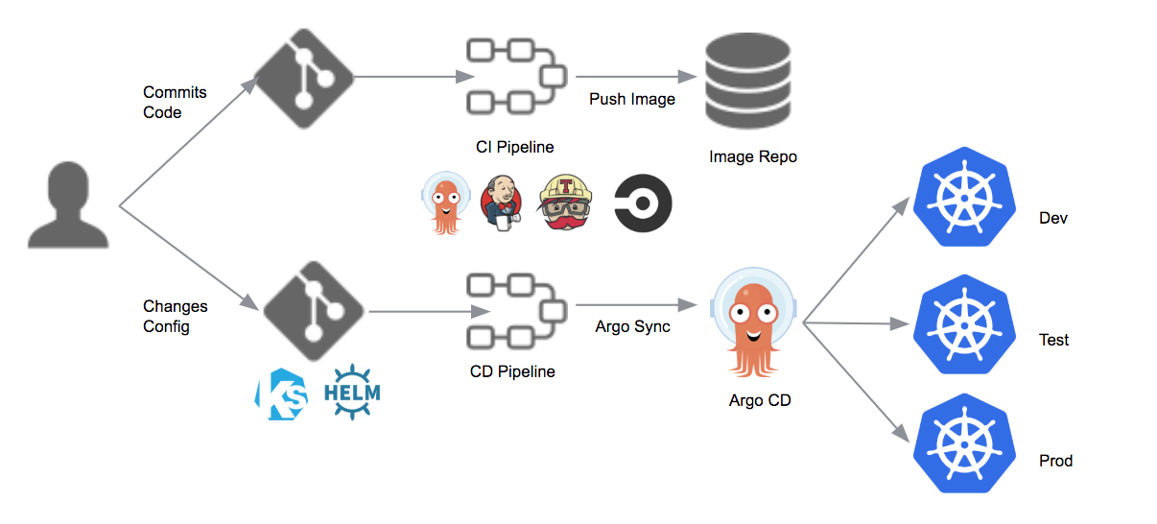
CI/CD Push Model – Invoke Argo Sync explicitly
Source: https://blog.argoproj.io/introducing-argo-cd-declarative-continuous-delivery-for-kubernetes-da2a73a780cd

Slide 21
ArgoCD Components – API Server
The API server is a gRPC/REST server which exposes the API consumed by the Web UI, CLI, and CI/CD systems.
It has the following responsibilities:
application management and status reporting
invoking of application operations (e.g., sync, rollback, user-defined actions)
repository and cluster credential management (stored as K8s secrets)
authentication and auth delegation to external identity providers
RBAC enforcement
listener/forwarder for Git webhook events

Slide 22
ArgoCD Components – Repository Server
The repository server is an internal service which maintains a local cache of the Git repository holding the application manifests.
It is responsible for generating and returning the Kubernetes manifests when provided the following inputs:
repository URL
revision (commit, tag, branch)
application path
template specific settings: parameters, helm values.yaml

Slide 23
ArgoCD Components – Application Controller
The application controller is a Kubernetes controller which continuously monitors running applications and compares the current, live state against the desired target state (as specified in the repo).
It detects OutOfSync application state and optionally takes corrective action.

Slide 24
ArgoCD Components – ApplicationSet controller
ApplicationSet is a CRD that can be used to generate multiple Applications.
The ApplicationSet controller monitors ApplicationSets and generates Applications.
It enables automation and greater flexibility managing Argo CD Applications by adding additional features:
Use a single Kubernetes manifest to target multiple Kubernetes clusters with Argo CD
Use a single Kubernetes manifest to deploy multiple applications from one or multiple Git repositories with Argo CD
Applications can be auto-generated from Git based on pre-defined ApplicationSet manifest typically applied onto the cluster by ArgoCD admin. Users do not need access to Kubernetes environment to create the Applications, they only need to add application manifests to git.

Slide 25
ArgoCD Components – Notifications Controller
Kubernetes controller that continuously monitors ArgoCD applications and sends out notifications
When? whenever configured trigger conditions are met [app created, deleted, health-degraded, synced etc ]
What? message templates are available for each trigger
Where? To notification service: email, slack, teams, webhook
Controller only watches those application which have annotation notifications.argoproj.io/subscribe.<trigger>.<service>: <recipient>
See https://argocd-notifications.readthedocs.io/en/stable/ for more details. As of v2.3, notifications controller is integrated into ArgoCD and does not need to be installed separately.

Slide 26
ArgoCD Installation Demo

Slide 27
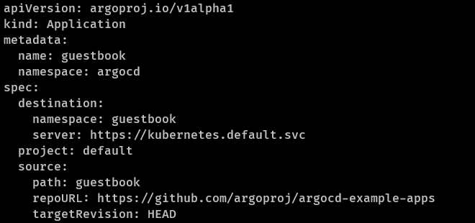
ArgoCD App Basic Example - Deploy from git

Slide 28
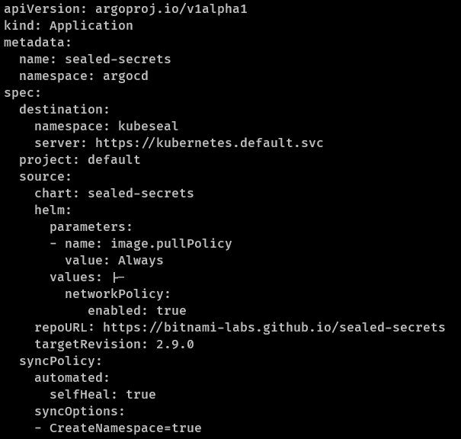
ArgoCD App – Deploy from helm registry
Useful only for deploying third-party charts with pre-configured values
Not “GitOps” Friendly since values file and chart version is embedded into Application spec
Only way to use “GitOps” features is to commit the Application definition into a repository and reference the git repo as source in another Git based Application definition so that, changes made in Git can be tracked by ArgoCD

Slide 29
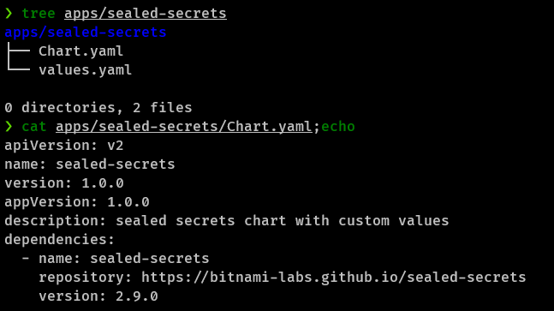
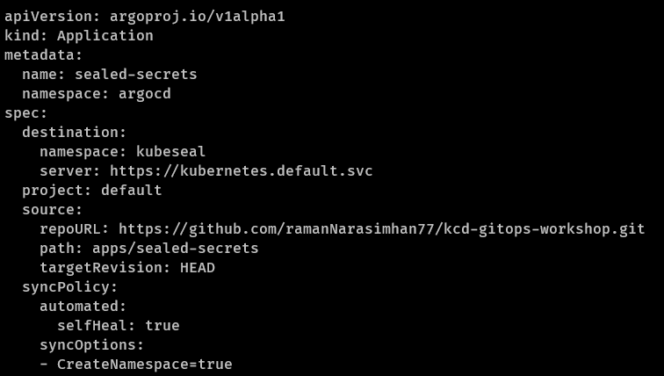
ArgoCD App – Deploy Helm chart in a GitOps Native fashion
apps/sealed-secret dir in git repo
App manifest

Slide 30
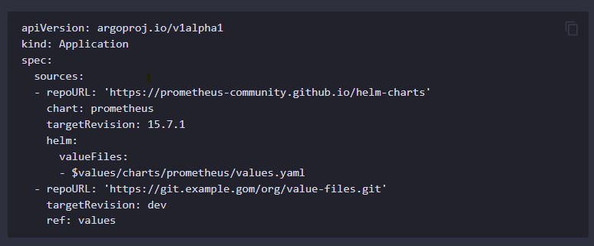
ArgoCD App – Multiple sources (BETA Feature added in v2.6) Example1: Deploy from helm registry with git-hosted values
Helm sources can reference value files from git sources. This allows you to use a third-party Helm chart with custom, git-hosted values. In the example, the prometheus chart will use the value file from git.example.gom/org/value-files.git. $values resolves to the root of the value-files repository. The $values variable may only be specified at the beginning of the value file path.
If the path field is set in the $values source, Argo CD will attempt to generate resources from the git repository at that URL. If the path field is not set, Argo CD will use the repository solely as a source of value files.

Slide 31
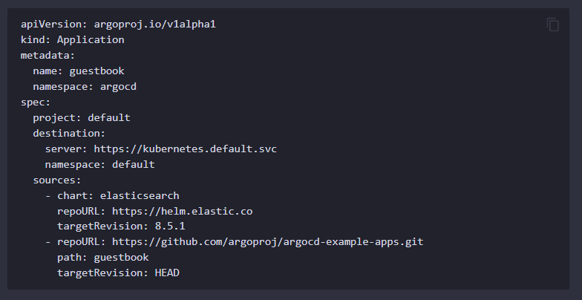
ArgoCD App – Multiple sources (BETA Feature added in v2.6) Example 2: Override Resources
The example has two sources specified. Argo CD will generate the manifests for each source separately and combine the resulting manifests.
If multiple sources produce the same resource (same group, kind, name, and namespace), the last source to produce the resource will take precedence. Argo CD will produce a RepeatedResourceWarning in this case, but it will sync the resources. This provides a convenient way to override a resource from a chart with a resource from a Git repo.

Slide 32
ArgoCD Applications Demo

Slide 33
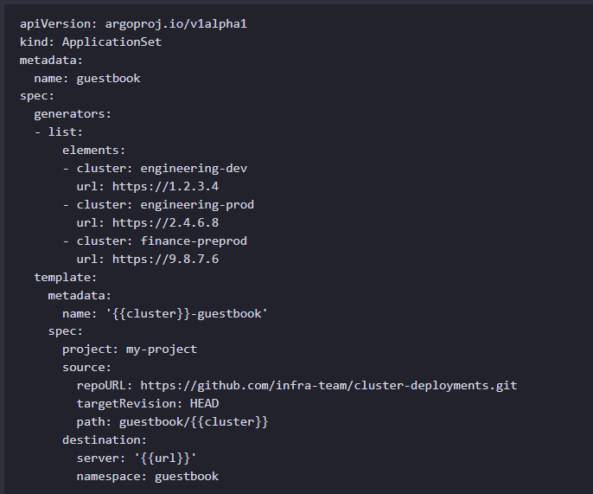
ApplicationSet – List Generator
This example deploys the guestbook application (with the Kubernetes resources for this application coming from Git) to a list of Kubernetes clusters (with the list of target clusters defined in the List items element of the ApplicationSet resource).

Slide 34
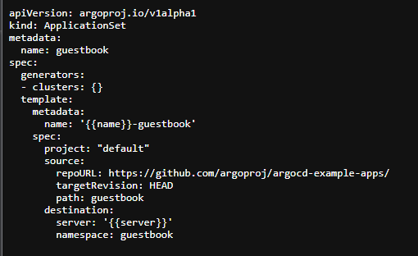
ApplicationSet – Cluster Generator
ArgoCD stores managed cluster details in form of secrets.
For each cluster registered with Argo CD, the Cluster generator produces parameters based on the list of items found within the cluster secret.
It automatically provides the following parameter values to the Application template for each cluster:
name
nameNormalized ('name' but normalized to contain only lowercase alphanumeric characters, '-' or '.')
server
metadata.labels.<key> (for each label in the Secret)
metadata.annotations.<key> (for each annotation in the Secret)

Slide 35
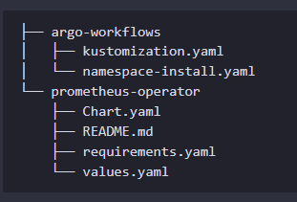
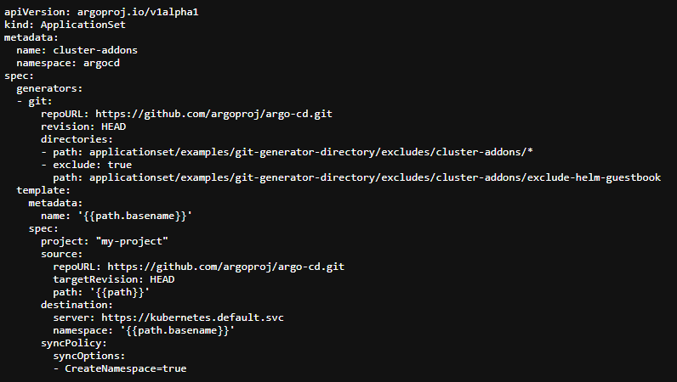
ApplicationSet – Git Generator
cluster-addons dir structure
Generator supports following params:
{{path}}
{{path.basename}}
{{path.basenameNormalized}} – Replaces unsupported chars like underscore with hypen
{{path[N]}} – Nth entry from array of dirs
Generator iterates through all configured directories and creates Applications

Slide 36
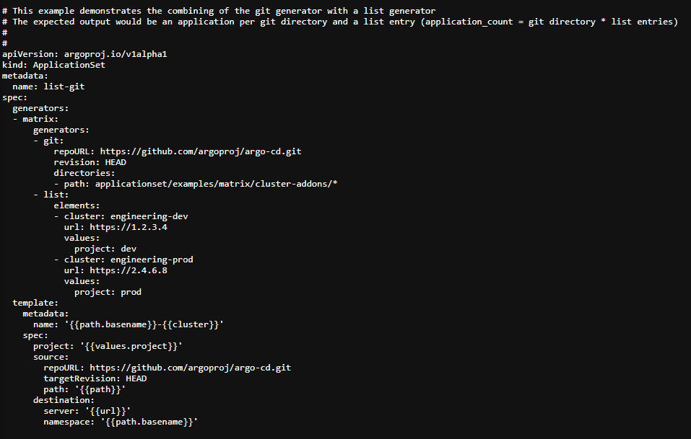
ApplicationSet – Matrix Generator
Matrix generator does the cross product of the output from 2 different generators
In the example shown, outputs from git generator and list generator are consolidated – applications from all discovered directories in git are deployed all clusters generated by the list generator: i.e to engineering-dev and engineering-prod clusters

Slide 37
ArgoCD Applicationset Demo

Slide 38
Helm Chart Apps - Hooks
Argo CD cannot know if it is running a first-time "install" or an "upgrade" - every operation is a "sync'. This means that, by default, apps that have pre-install and pre-upgrade will have those hooks run at the same time.
Make your hook idempotent. Do not use non-deterministic functions like rand
Annotate crds with hook-weight: "-2" to make sure it runs to success before any install or upgrade hooks.
Annotate pre-install and post-install with hook-weight: "-1". This will make sure it runs to success before any upgrade hooks.
Annotate pre-upgrade and post-upgrade with hook-delete-policy: before-hook-creation to make sure it runs on every sync.

Slide 39
Helm chart App – Supported Hooks
Helm Annotation | Notes
helm.sh/hook: pre-delete | Not supported. In Helm stable there are 3 cases used to clean up CRDs and 3 to clean-up jobs.
helm.sh/hook: pre-rollback | Not supported. Never used in Helm stable.
helm.sh/hook: pre-install | Supported as equivalent to argocd.argoproj.io/hook: PreSync.
helm.sh/hook: pre-upgrade | Supported as equivalent to argocd.argoproj.io/hook: PreSync.
helm.sh/hook: post-upgrade | Supported as equivalent to argocd.argoproj.io/hook: PostSync.
helm.sh/hook: post-install | Supported as equivalent to argocd.argoproj.io/hook: PostSync.
helm.sh/hook: post-delete | Not supported. Never used in Helm stable.
helm.sh/hook: post-rollback | Not supported. Never used in Helm stable.
helm.sh/hook: test-success | Not supported. No equivalent in Argo CD.
helm.sh/hook: test-failure | Not supported. No equivalent in Argo CD.
helm.sh/hook-delete-policy | Supported. See also argocd.argoproj.io/hook-delete-policy).
helm.sh/hook-delete-timeout | Not supported. Never used in Helm stable
helm.sh/hook-weight | Supported as equivalent to argocd.argoproj.io/sync-wave.
helm.sh/resource-policy: keep | Supported as equivalent to argocd.argoproj.io/sync-options: Delete=false.

Slide 40
Webhooks and Manifest Path Annotation
ArgoCD aggressively caches generated manifests using Commit SHA as cache key
Hence a new commit to any dir can invalidate the cache manifests for all applications generated from the same repository
It is recommended to use Git Webhooks and add argocd.argoproj.io/manifest-generate-paths annotation to the Application custom resource to solve this problem.

Slide 41
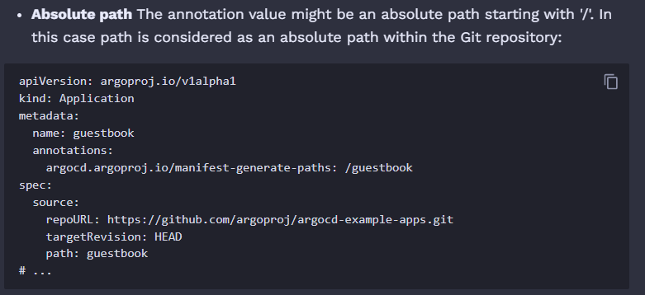
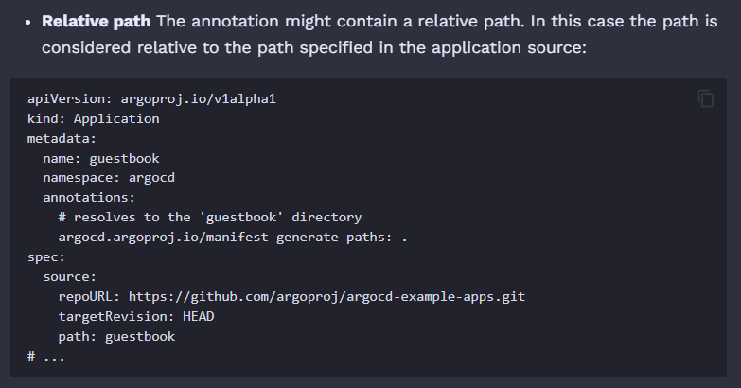
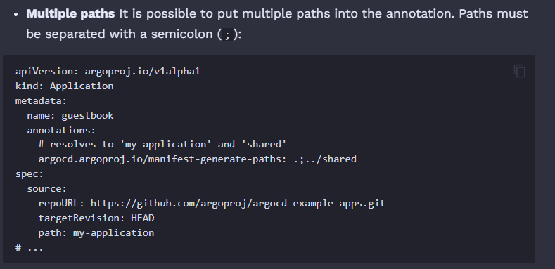
Webhooks and Manifest Path Annotation [Contd..]
This annotation contains a semicolon-separated list of paths within the Git repository that are to be used during manifest generation.
The webhook compares paths specified in the annotation with the changed files specified in the webhook payload.
If no modified files match the paths specified in argocd.argoproj.io/manifest-generate-paths, then the webhook will not trigger application reconciliation and the existing cache will be considered valid for the new commit.
Source: https://argo-cd.readthedocs.io/en/stable/operator-manual/high_availability/#webhook-and-manifest-paths-annotation

Slide 42
ArgoCD Feature Summary
Automated deployment of applications to specified target environments
Support for multiple config management/templating tools (Kustomize, Helm, Jsonnet, plain-YAML)
Ability to manage and deploy to multiple clusters
SSO Integration (OIDC, OAuth2, LDAP, SAML 2.0, GitHub, GitLab, Microsoft, LinkedIn)
Rollback/Roll-anywhere to any application configuration committed in Git repository
Health status analysis of application resources
Automated configuration drift detection and visualization
Automated or manual syncing of applications to its desired state
Web UI which provides real-time view of application activity
CLI for automation and CI integration
Webhook integration (GitHub, BitBucket, GitLab)
PreSync, Sync, PostSync hooks to support complex application rollouts (e.g.blue/green & canary upgrades)
Audit trails for application events and API calls
Prometheus metrics
Parameter overrides for overriding helm parameters in Git

Slide 43

THANK YOU

